Slide 1
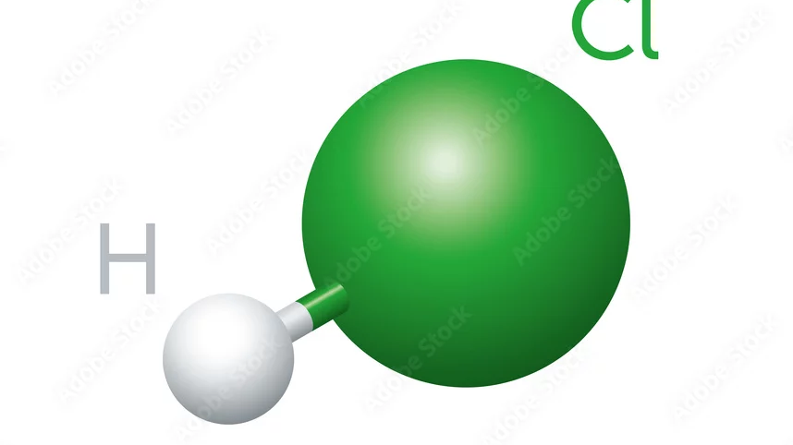
Molecular Dynamics - 6: Langevin Thermostat applied to a 3D system
Jean Choppin de Janvry & Rachel Wolf

Slide 2
Table of contents
Objectives
Simulations
a. Without Thermostat
b. With Thermostat
III. Conclusion

Slide 3
Table of contents
Objectives
Simulations
a. Without Thermostat
b. With Thermostat
III. Conclusion

Slide 4
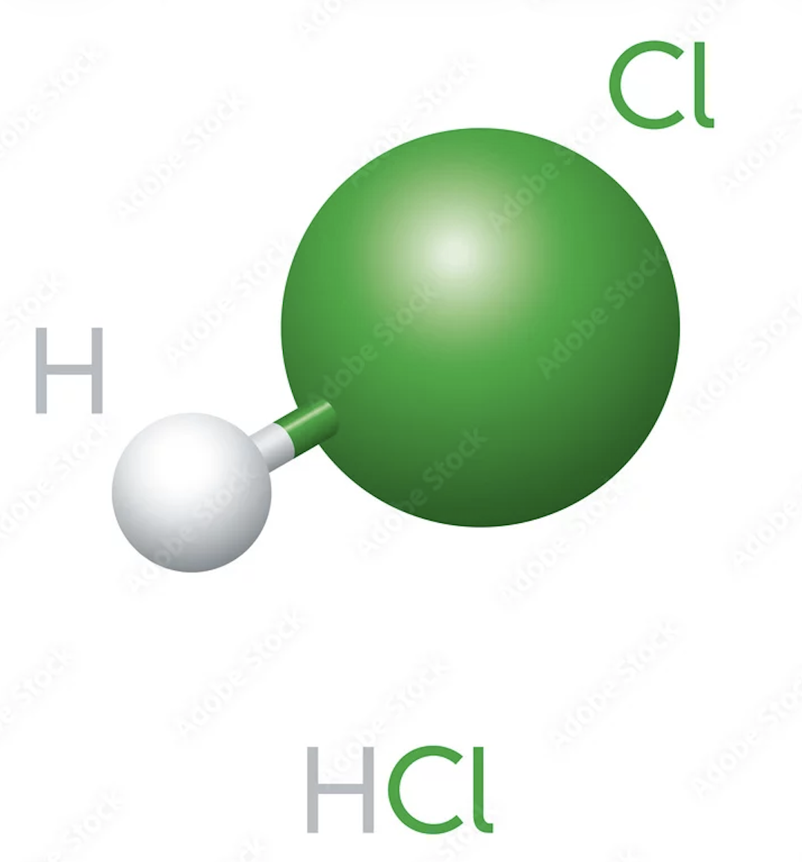
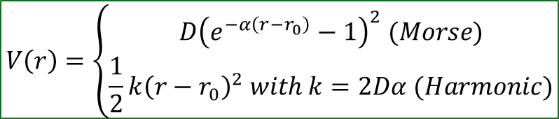
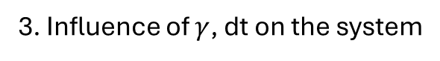
Objectives
Simulate the movement of HCl in 3D
in a Langevin Thermostat
Simulate HCl with MD method
Coherence (equipartition theorem) ?
2. Simulate HCL with Langevin MD method
Coherence (equipartition theorem) ?
3. Influence of $γ$, dt on the system
4. Rotation-Vibration Coupling
$$V\left(r\right)=\left\{\begin{aligned}D{\left(e^{−α\left(r−r_{0}\right)}−1\right)}^{2} (Morse) \\ \frac{1}{2}k{\left(r−r_{0}\right)}^{2} with k=2Dα (Harmonic)\end{aligned}\right.$$
Interaction potential

Slide 5
Table of contents
Objectives
Simulations
a. Without Thermostat
b. With Thermostat
III. Conclusion

Slide 6
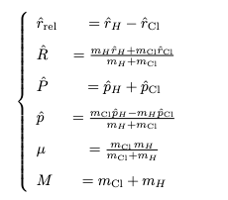
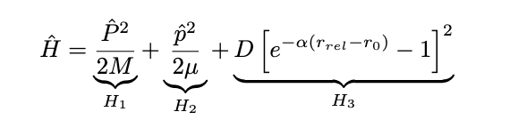
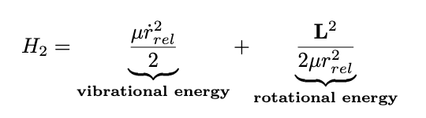
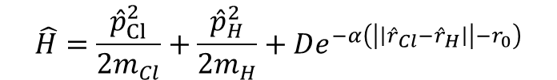
Hamiltonian
Simulations
Without the thermostat
$$\hat{H}=\frac{{\hat{p}}_{Cl}^{2}}{2m_{Cl}}+\frac{{\hat{p}}_{H}^{2}}{2m_{H}}+De^{−α\left(\left|\left|{\hat{r}}_{Cl}−{\hat{r}}_{H}\right|\right|−r_{0}\right)}$$
1st approach: Reduced Mass
With
Energies:
COM translational energy
vibrational potential energy
Could not compute energies !
2nd approach: 3D
Position and speed of Cl and H in 3D

Slide 7
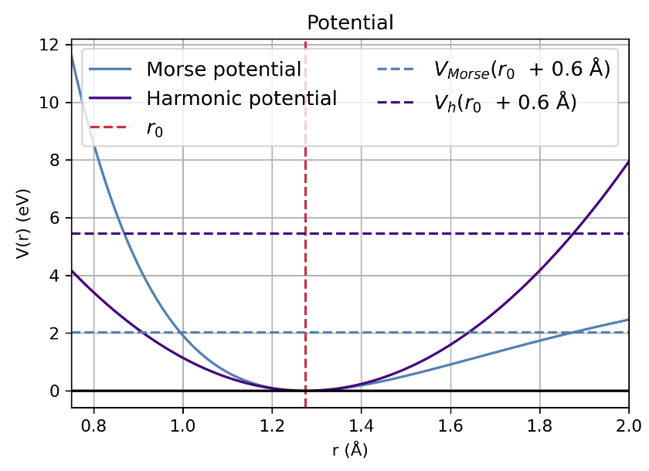
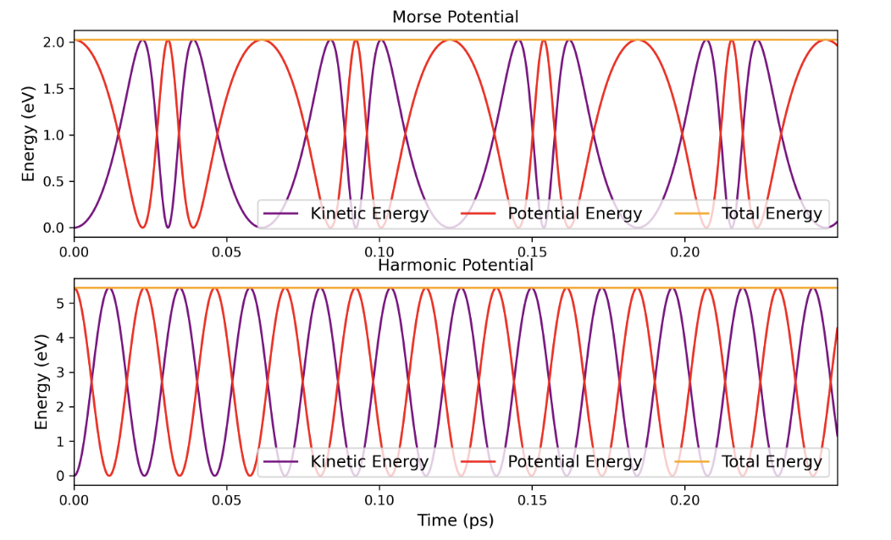

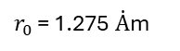
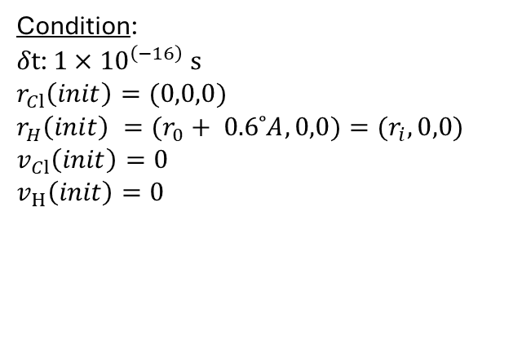
Comparison between Morse and Harmonic potential
Simulations
Without the thermostat
Position and speed of Cl and H computed with Verlet algorithm and Langevin Algorithm for consistency checks
Computed in both reduced mass scheme and 3D scheme
Condition:
$δt$: ${1×10}^{\left(−16\right)} s$
$r_{Cl}\left(init\right)=(0,0,0)$
$r_{H}\left(init\right) =(r_{0}+ 0.6˚A, 0,0)={(r}_{i},0,0)$
$v_{Cl}\left(init\right)=0$
$v_{H}\left(init\right)=0$
Verification: Em = Ec + Ep
$r_{0 }$= 1.275 $\dot{A}$m
Note : we use dimensionned variables, with energies in eV and distances in Angströms for numerical stability

Slide 8
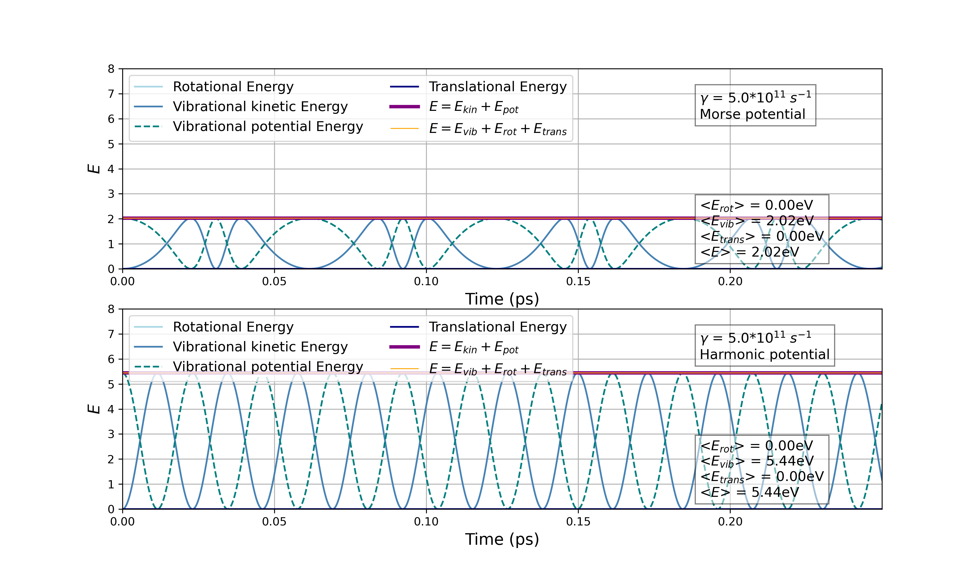
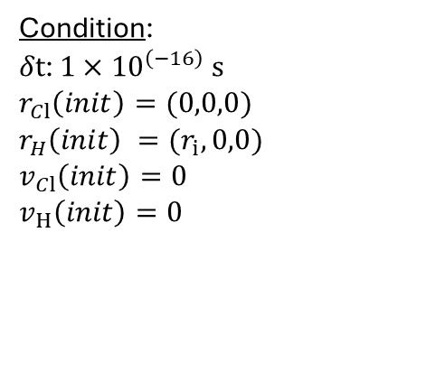
Decomposition of energies
Simulations
Without the thermostat
Condition:
$δt$: ${1×10}^{\left(−16\right)} s$
$r_{Cl}\left(init\right)=(0,0,0)$
$r_{H}\left(init\right) =(r_{i}, 0,0)$
$v_{Cl}\left(init\right)=0$
$v_{H}\left(init\right)=0$
All of the energy is vibrational in the case of no thermostat. The molecule simply vibrates along its axis, going over the potential.
Decomposition of energies into ($E_{vib}$ ), translational ($E_{trans}$) and rotational ($E_{rot}$) energies.

Slide 9
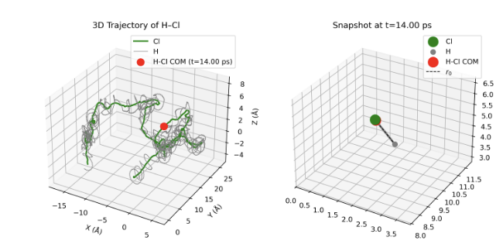
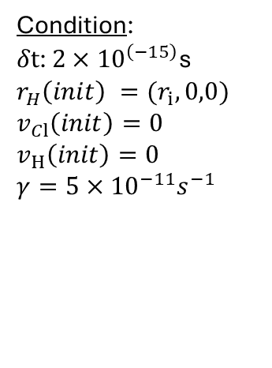
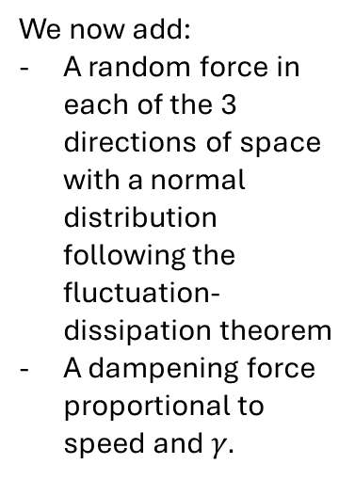
H-Cl 3D Trajectory
Simulations
With the thermostat
Condition:
$δt$: ${2×10}^{\left(−15\right)}$s
$r_{H}\left(init\right) =(r_{i}, 0,0)$
$v_{Cl}\left(init\right)=0$
$v_{H}\left(init\right)=0$
$γ={5×10}^{−11}s^{−1}$
We now add:
A random force in each of the 3 directions of space with a normal distribution following the fluctuation-dissipation theorem
A dampening force proportional to speed and $γ.$
Showcasing the molecule trajectory (both H, Cl) in 3D space, as well as the position of the Center of Mass (COM) at the chosen time frame
COM is very close to the green trajectory at all times since m(Cl)/m(H) >> 1

Slide 10
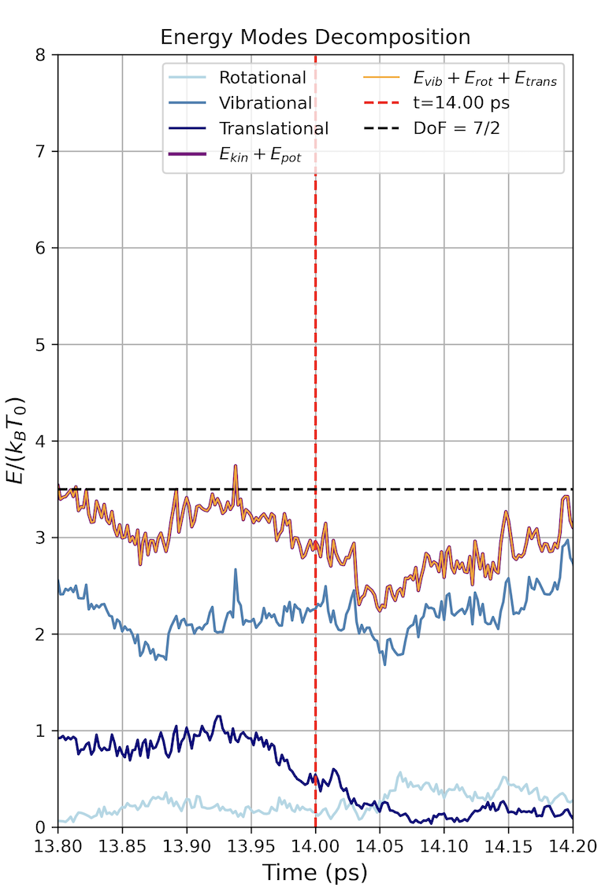

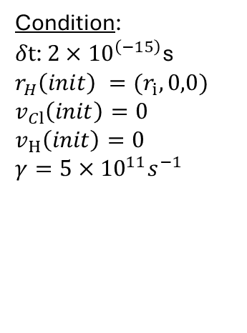
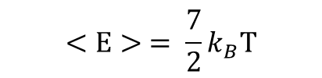
Decomposition of energies
Simulations
With the thermostat
Verification of Equipartition Theorem
Condition:
$δt$: ${2×10}^{\left(−15\right)}$s
$r_{H}\left(init\right) =(r_{i}, 0,0)$
$v_{Cl}\left(init\right)=0$
$v_{H}\left(init\right)=0$
$γ={5×10}^{11}s^{−1}$
3 dof : translational kinetic energy
2 dof: vibrational kinetic energy
2 dof: rotational kinetic energy
$$<E> = \frac{7}{2}k_{B}T$$
Decomposition of energies into ($E_{vib}$ ), translational ($E_{trans}$) and rotational ($E_{rot}$) energies.

Slide 11
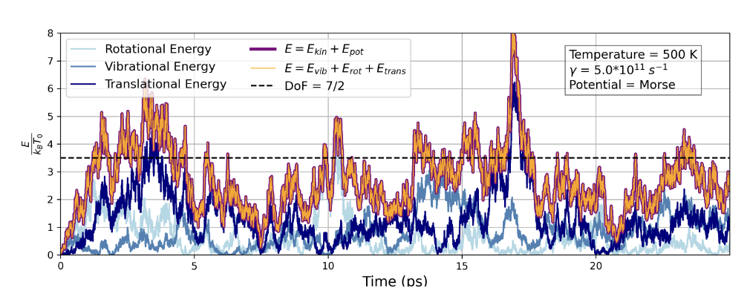


Decomposition of energies
Simulations
With thermostat
Position and speed of Cl and H computed with modified Verlet algo
Condition:
$δt$: ${2×10}^{\left(−15\right)}$s
$r_{H}\left(init\right) =(r_{i}, 0,0)$
$v_{Cl}\left(init\right)=0$
$v_{H}\left(init\right)=0$
$γ={5×10}^{11}s^{−1}$
Decomposition of energies into ($E_{vib}$ ), translational ($E_{trans}$) and rotational ($E_{rot}$) energies.
$$E_{vib}=E_{vib,kin}+E_{vib,pot}$$
Verification Equipartition Theorem
$$<E> = \frac{7}{2}{ k}_{B}T$$

Slide 12
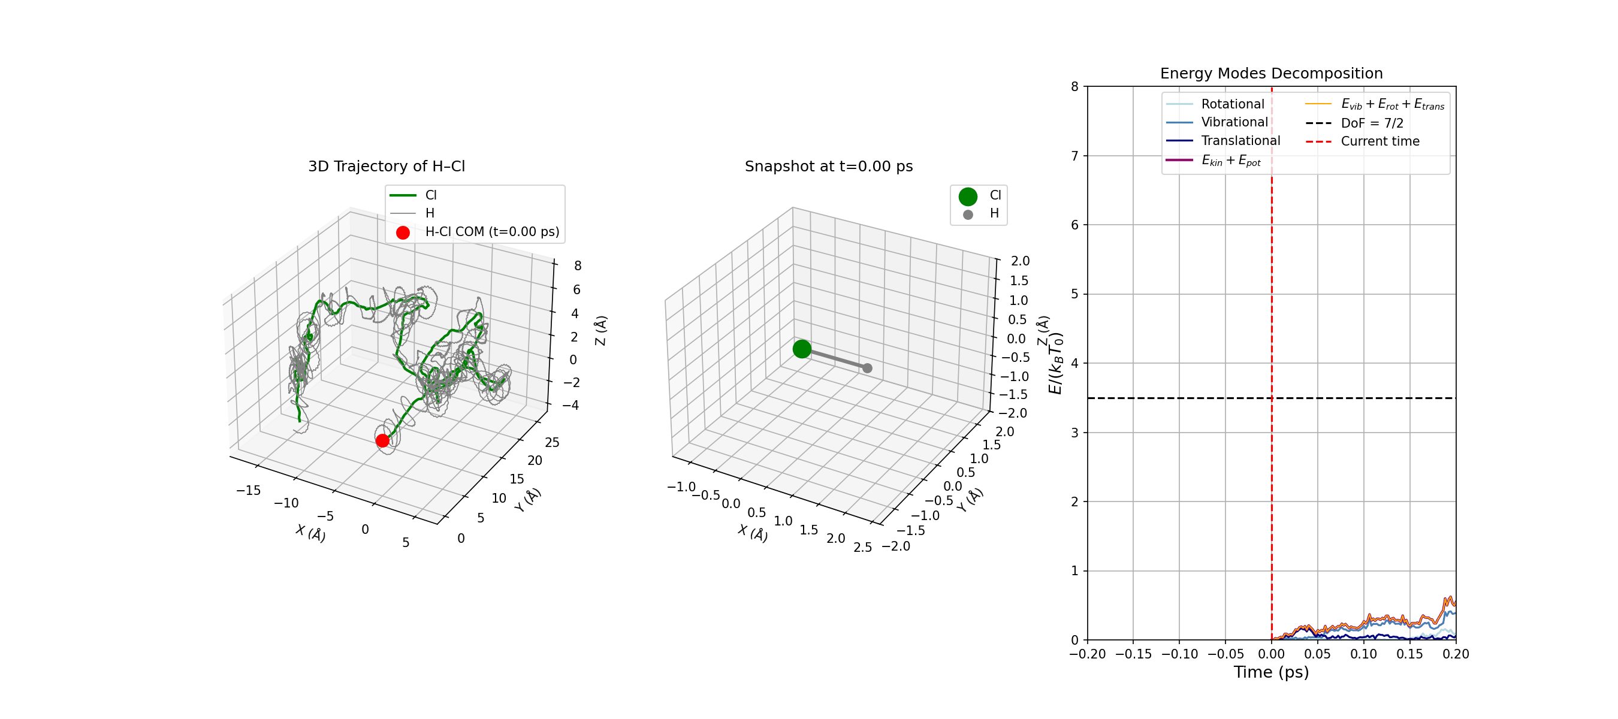
Decomposition of energies
Simulations
With thermostat
Condition:
$δt$: ${2×10}^{\left(−15\right)}$s
$r_{H}\left(init\right) =(r_{i}, 0,0)$
$v_{Cl}\left(init\right)=0$
$v_{H}\left(init\right)=0$
$γ={5×10}^{11}s^{−1}$

Slide 13
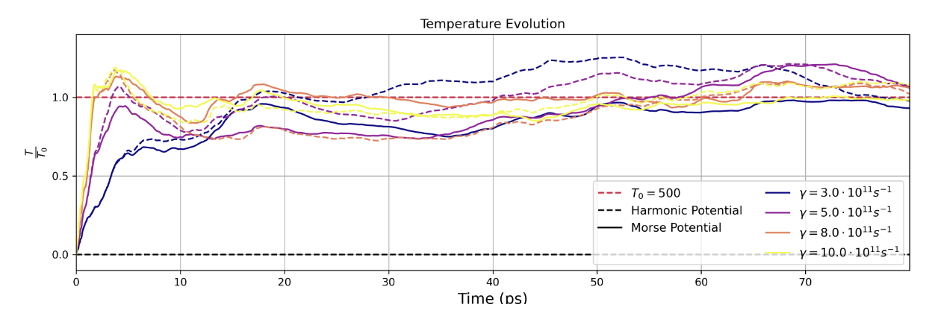

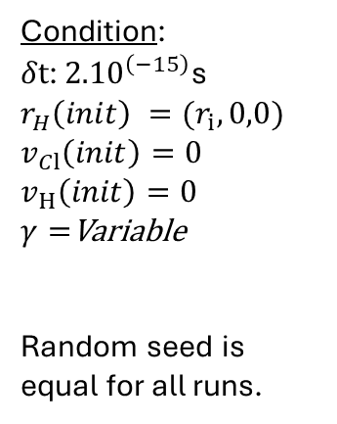
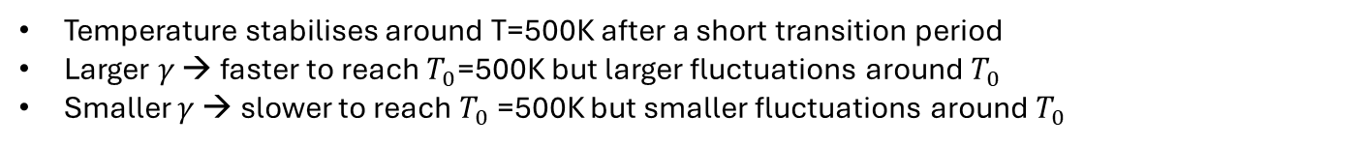
Influence of $γ$
Simulations
Condition:
$δt$: ${2.10}^{\left(−15\right)}$s
$r_{H}\left(init\right) =(r_{i}, 0,0)$
$v_{Cl}\left(init\right)=0$
$v_{H}\left(init\right)=0$
$γ=$Variable
Random seed is equal for all runs.
Evolution of relative temperature for a thermostat $T_{0}$= 500K with different values of γ over 80ps.
Conclusion:
Temperature stabilises around T=500K after a short transition period
Larger $γ$ → faster to reach $T_{0}$=500K but larger fluctuations around $T_{0}$
Smaller $γ$ → slower to reach $T_{0}$=500K but smaller fluctuations around $T_{0}$

Slide 14
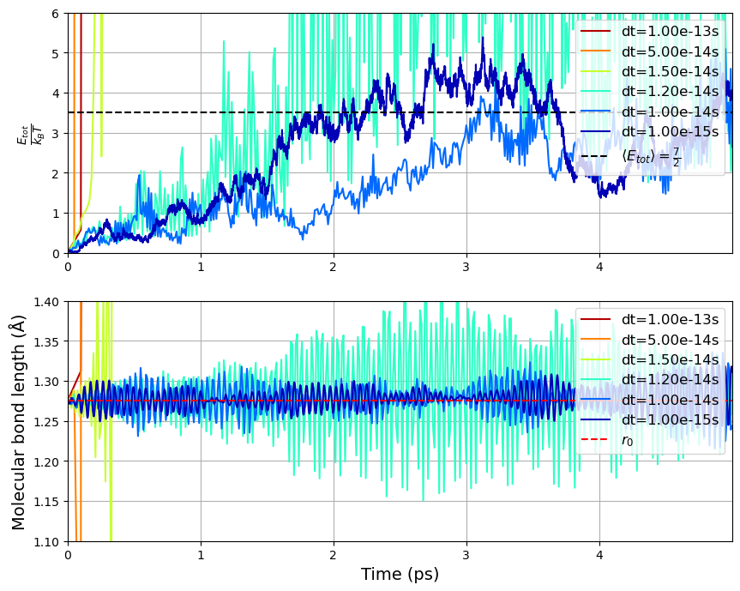
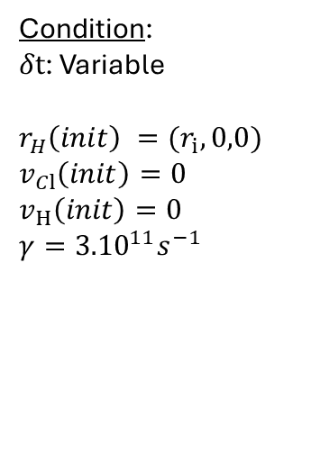

Influence of $δt$
Simulations
The time sampling also affects the simulations, with divergent simulations for steps above 10ps, and different divergent regimes :
Larger amplitude (cyan, dt=1.2e-14s)
Starts okay, diverges (green, dt=1.5e-14s)
Fully divergent (orange, red, dt > 5e-14s
Condition:
$δt$: Variable
$r_{H}\left(init\right) =(r_{i}, 0,0)$
$v_{Cl}\left(init\right)=0$
$v_{H}\left(init\right)=0$
$γ={3.10}^{11}s^{−1}$
Evolution of simulations for variable dt at fixed gamma.

Slide 15
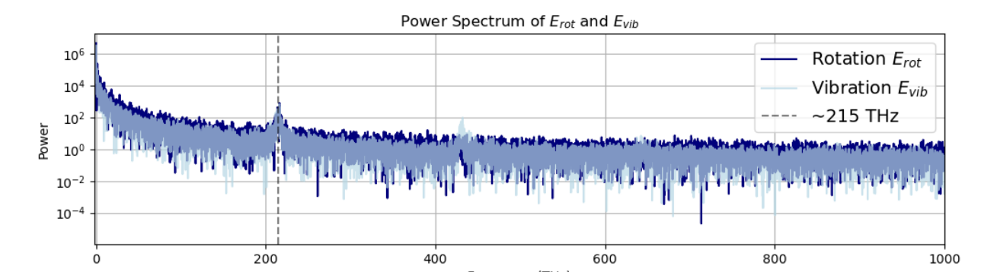
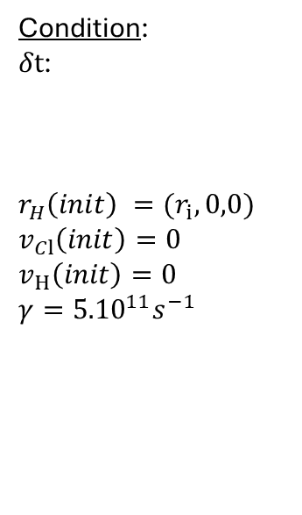
Rotation-Vibration Coupling
Simulations
Condition:
$δt$:
$r_{H}\left(init\right) =(r_{i}, 0,0)$
$v_{Cl}\left(init\right)=0$
$v_{H}\left(init\right)=0$
$γ={5.10}^{11}s^{−1}$
Frequences (THz)
FFT: Identify the oscillations’ main frequencies
Peak around ~215THz for both Erot, Evib
Following harmonics only visible for Evib
Power spectrum (Fast fourier transform, FFT) of $E_{rot}$ and $E_{vib,kin}.$
This is due to the inertia proportional to the relative distance modulus, which fluctuates at the frequency of vibration. However, L must be preserved, so necessarily the rotational energy fluctuates at the same frequency as the vibrations.
Conclusion:
Coincidence of the main frequency peak in both spectra
→ a rotational–vibrational coupling (not independent)

Slide 16
Table of contents
Objectives
Simulations
a. Without Thermostat
b. With Thermostat
III. Conclusion

Slide 17
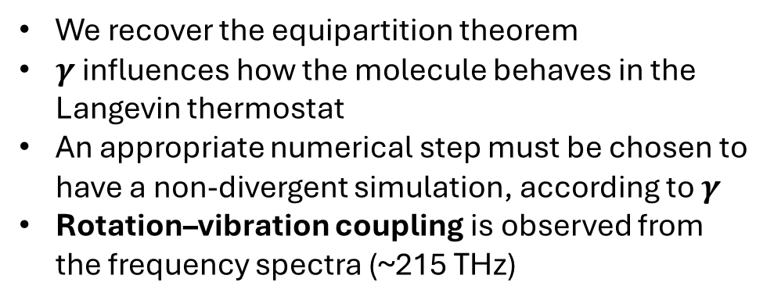
Conclusion
Key take-aways:
We recover the equipartition theorem
$γ$influences how the molecule behaves in the Langevin thermostat
An appropriate numerical step must be chosen to have a non-divergent simulation, according to $γ$
Rotation–vibration coupling is observed from the frequency spectra (~215 THz)
Future improvements:
Adding more molecules to smooth out temperature evaluations, potentially looking at collisions as well
Looking at the influence of setting an initial speed or a starting temperature in the case of a thermostat
In the code : multiprocessing, more vectorization, numba or jit…
Thank you for your attention!

